Slide 1

Foundation PHYSICS
Seminar 10: Inductance, em oscillations and ac circuits

Slide 2
Learning outcomes
Students will be able to :
Understand inductance and how it differs from resistance and capacitance.
Solve problems related to RLC and RL circuits.
Solve problems of an AC circuits.

Slide 3



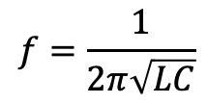

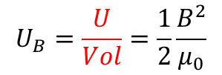



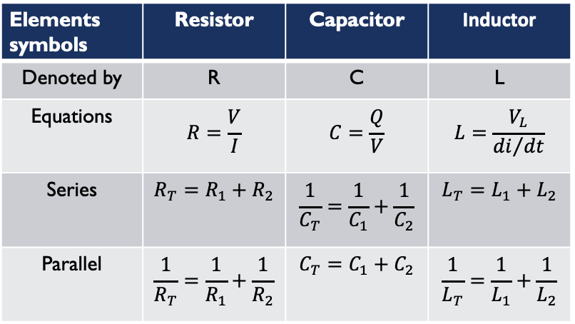


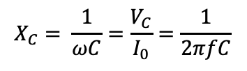
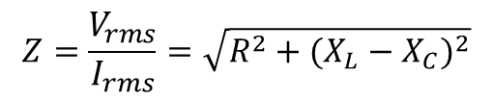





Elements symbols | Resistor | Capacitor | Inductor
Denoted by | R | C | L
Equations | $$R=\frac{V}{I}$$ | $$C=\frac{Q}{V}$$ | $$L=\frac{V_{L}}{{di}/{dt}}$$
Series | $$R_{T}=R_{1}+R_{2}$$ | $$\frac{1}{C_{T}}=\frac{1}{C_{1}}+\frac{1}{C_{2}}$$ | $$L_{T}=L_{1}+L_{2}$$
Parallel | $$\frac{1}{R_{T}}=\frac{1}{R_{1}}+\frac{1}{R_{2}}$$ | $$C_{T}=C_{1}+C_{2}$$ | $$\frac{1}{L_{T}}=\frac{1}{L_{1}}+\frac{1}{L_{2}}$$
Total impedance $(Z)$ in LCR Circuit:
$$Z=\frac{V_{rms}}{I_{rms}}=\sqrt{R^{2}+{(X_{L}−X_{C})}^{2}}$$
Energy $U$ stored in the inductor:
$$U=\frac{1}{2}LI^{2}$$
Energy $U$ stored in the capacitor:
$$U=\frac{1}{2}CV^{2}$$
Reactance of A Capacitor:
Frequency in LRC circuit:
Energy $U$ density in magnetic field (B):
$$f=\frac{1}{2π\sqrt{LC}}$$
$$U_{B}=\frac{U}{Vol}=\frac{1}{2}\frac{B^{2}}{μ_{0}}$$
$$X_{C}= \frac{1}{ωC}=\frac{V_{C}}{I_{0}}=\frac{1}{2πfC}$$
Energy $U$ density in Electric field (E):
Reactance of A Inductor:
Current in LR Circuit:
$$U_{E}=\frac{U}{Vol}=\frac{1}{2}ε_{0}E^{2}$$
$$X_{L}= ωL=\frac{V_{L}}{I_{0}}=2πfL$$
$$I=I_{0}\left(1−e^{−\frac{t}{τ}}\right)$$
where$τ$=$\frac{L}{R}$.

Slide 4
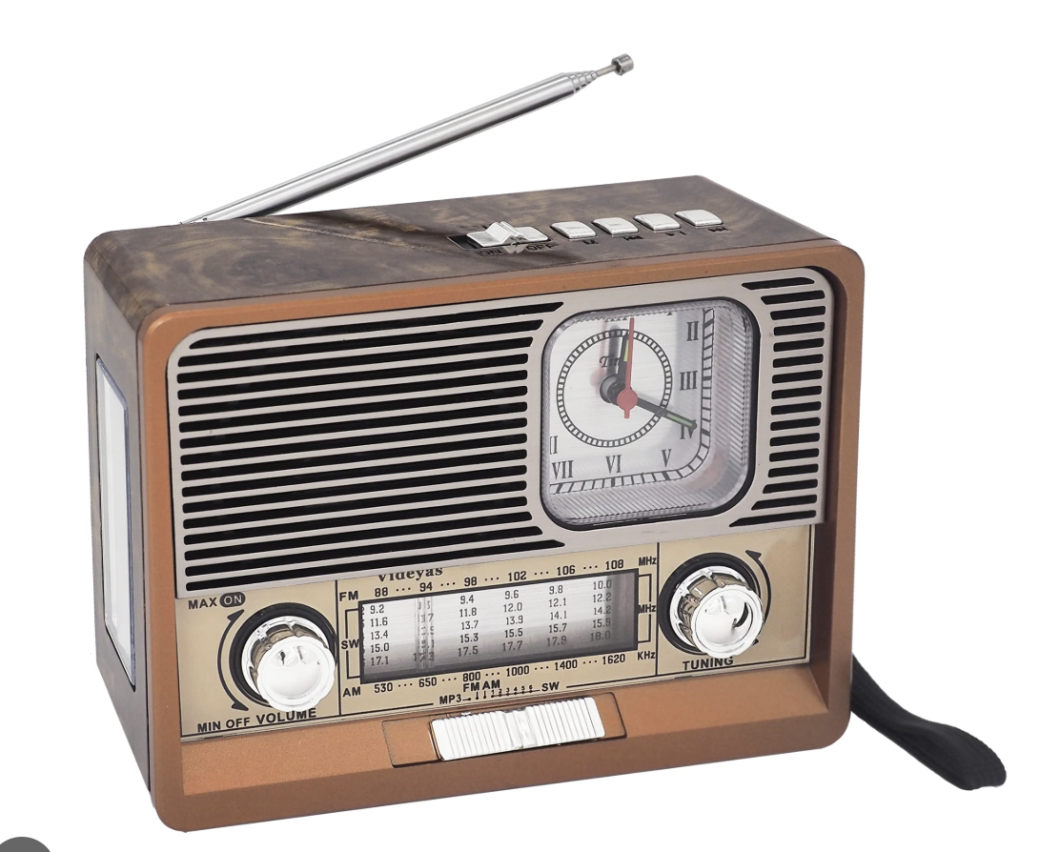
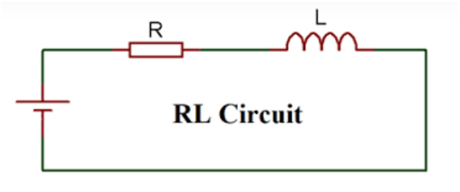
Practice Questions
1. An old-fashioned radio has a circuit with a resistor, inductor, and capacitor (LRC circuit) in series. The circuit is tuned to a specific frequency to receive a clear signal from a radio station.
What happens to the current in the circuit when the frequency of the incoming radio signal matches the natural resonant frequency of the LRC circuit? Why?
How could adjusting the values of the circuit components (R, L, or C) change which station is received clearly?
Why is energy lost in an LR circuit primarily due to the resistor, and not the inductor?

Slide 5
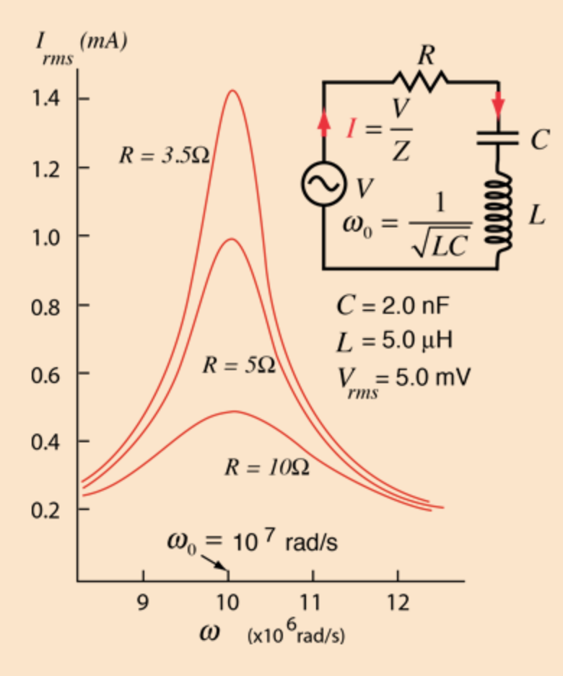
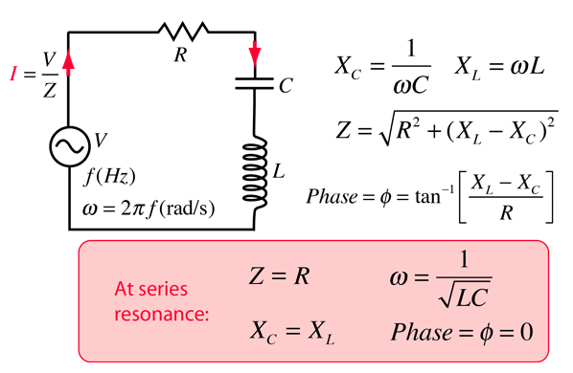
ANSWER: Practice Question 1
When the incoming signal matches the resonant frequency,
the current in the circuit reaches its maximum value.
At resonance, the inductive reactance X_{L}
and capacitive reactance X_{C} cancel each other out
because they are equal in magnitude but opposite in phase.
This minimizes the total impedance
of the circuit to just the resistance R,
allowing the current to be at its highest.

Slide 6
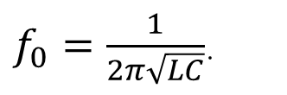
ANSWER: Practice Question 1
Adjusting the values of L or C changes the resonant frequency. The resonant frequency of the circuit is given by:
$f_{0}=\frac{1}{2π\sqrt{LC}}$.
Increasing the inductance L or capacitance C lowers the resonant frequency,
allowing the circuit to tune to stations with lower frequencies.
Decreasing L or C raises the resonant frequency, tuning to stations with higher frequencies.
By fine-tuning L or C, the circuit can selectively amplify signals from a desired station
while ignoring others.

Slide 7
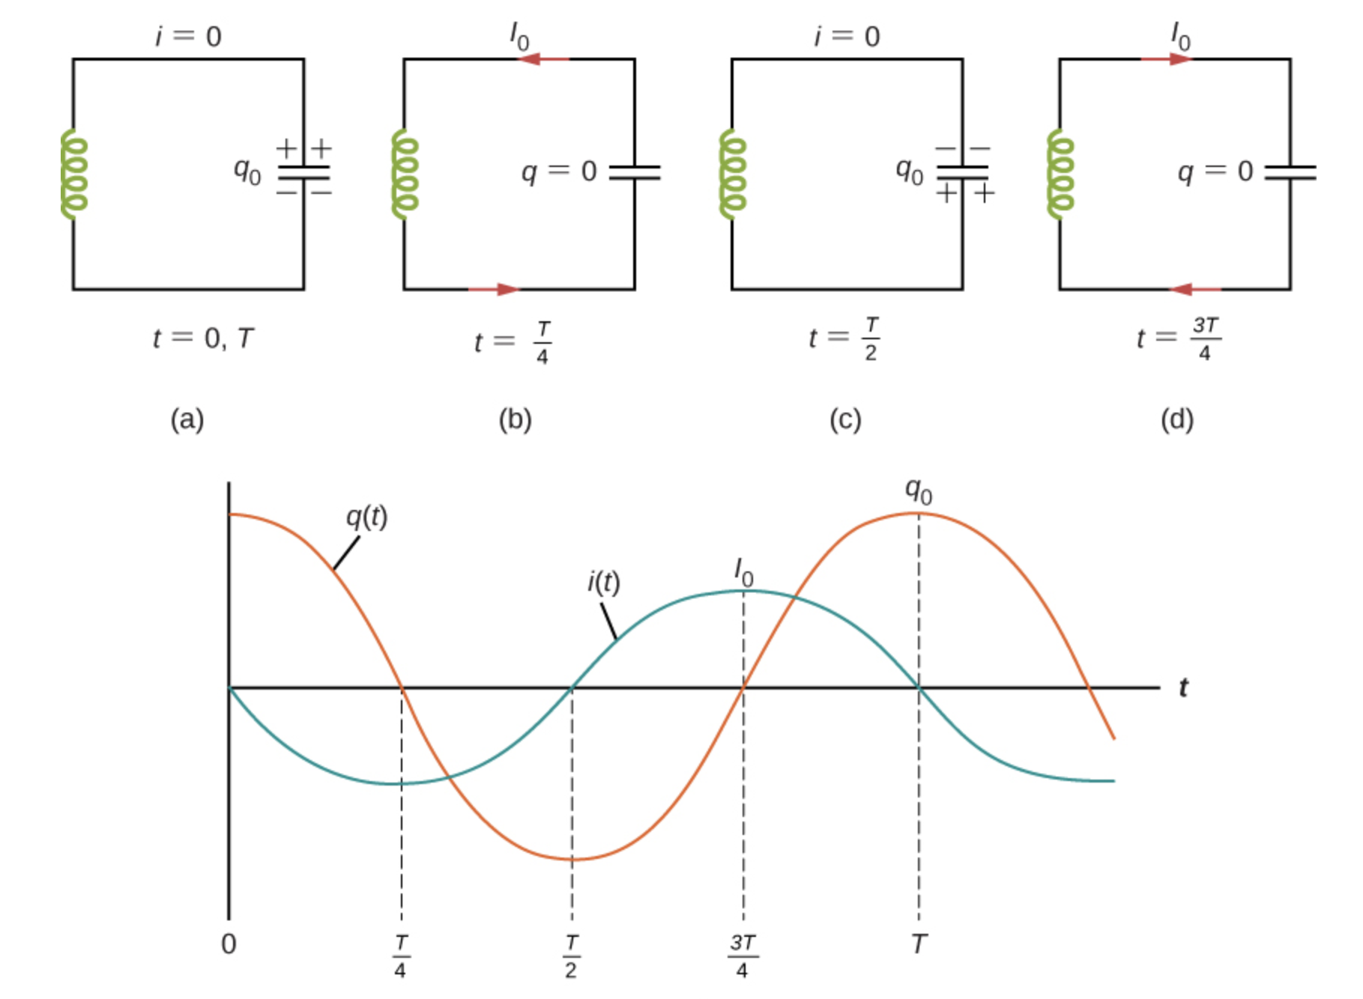
ANSWER: Practice Question 2
Energy loss in the resistor is due to heat dissipation (Joule heating), whereas the inductor stores and returns energy to the circuit without a net loss, thus acting ideally as an energy storage element rather than an energy dissipating element.
For example, an “ideal” RC circuit would oscillate with no loses…

Slide 8
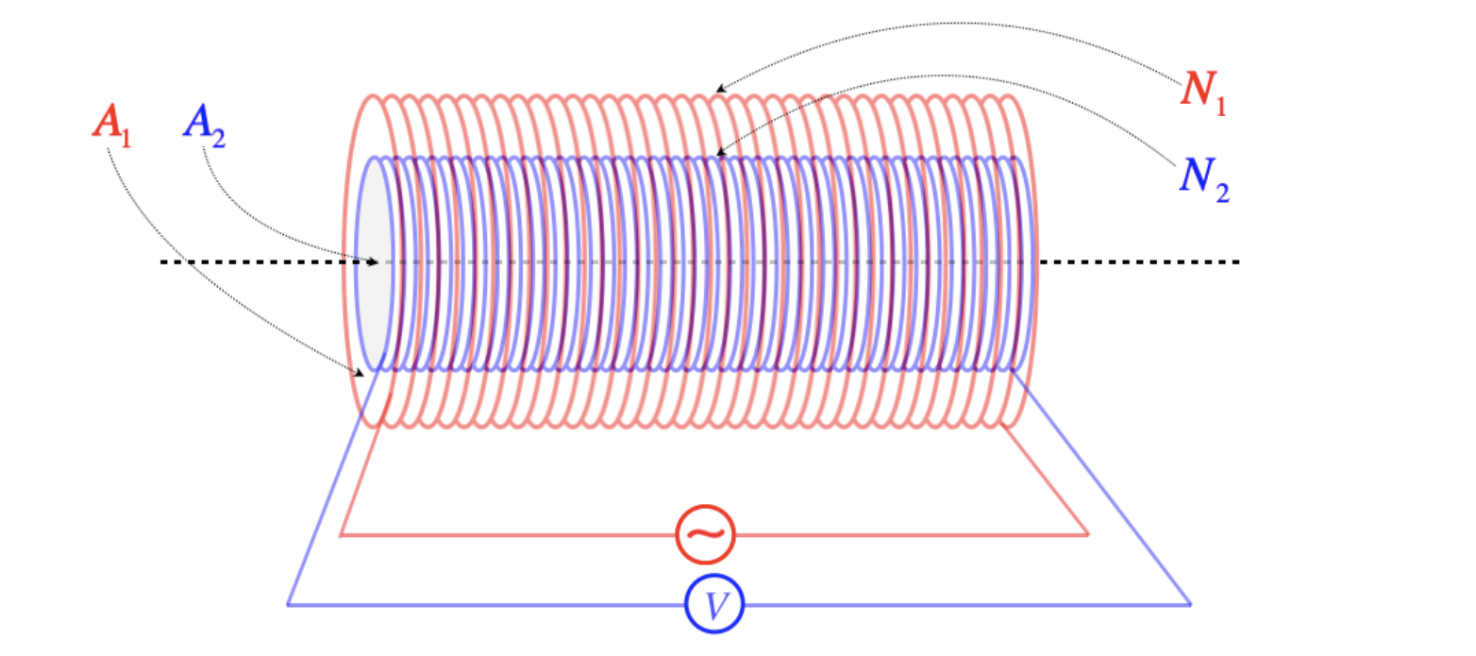
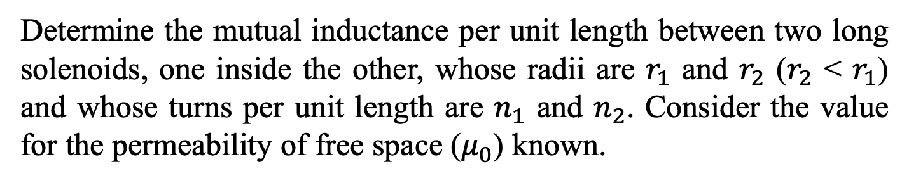
Question 1
Determine the mutual inductance per unit length between two long solenoids, one inside the other, whose radii are $r_{1}$ and $r_{2}$ ($r_{2}$ < $r_{1}$) and whose turns per unit length are $n_{1}$ and $n_{2}$. Consider the value for the permeability of free space ($μ_{0}$) known.

Slide 9







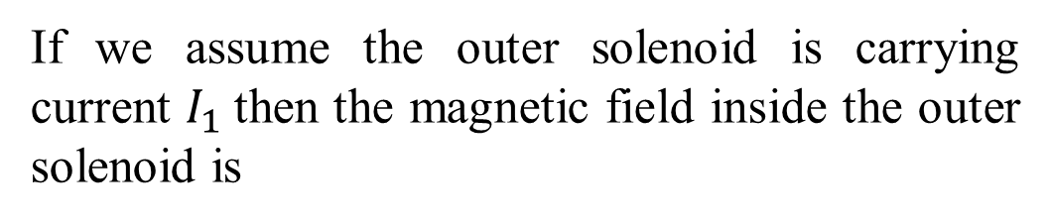

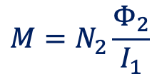
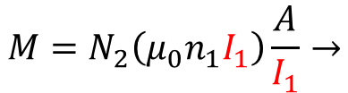

Question 1: ANSWERS
We know that if there are two solenoid of equal length and one solenoid is placed co-axially inside the other solenoid then the mutual inductance of the solenoid 1 with respect to solenoid 2 will be equal to the mutual inductance of solenoid 2 with respect to solenoid 1.
$$M=N_{2}\frac{Φ_{2}}{I_{1}}$$
$$M_{21}=M_{12}=M$$
If we assume the outer solenoid is carrying current $I_{1}$then the magnetic field inside the outer solenoid is
$$B_{1}=μ_{0}n_{1}I_{1}$$
Hence the flux in the second is:
$$Φ_{2}=B_{1}A2$$
$$Φ_{2}=\left(μ_{0}n_{1}I_{1}\right)A2$$
$$n_{2}=\frac{N_{2}}{l}→$$
$$A_{2}=πr_{2}^{2}$$
$${N_{2}=n}_{2}l$$
$$M=N_{2}\left(μ_{0}n_{1}I_{1}\right)\frac{A}{I_{1}}→$$
$$\frac{M}{l}=μ_{0}n_{1}n_{2}πr_{2}^{2}$$
$$M=μ_{0}n_{1}n_{2}lπr_{2}^{2}→$$

Slide 10
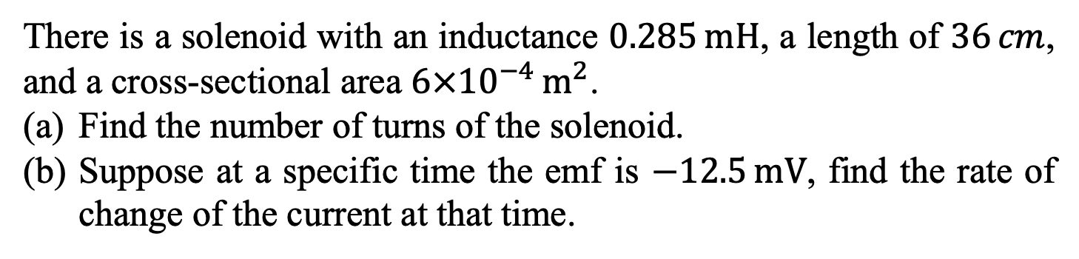
Question 2
There is a solenoid with an inductance $0.285 mH$, a length of $36 cm$, and a cross-sectional area $6×{10}^{−4} m^{2}$.
Find the number of turns of the solenoid.
Suppose at a specific time the emf is $−12.5 mV$, find the rate of change of the current at that time.

Slide 11



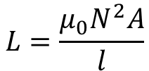

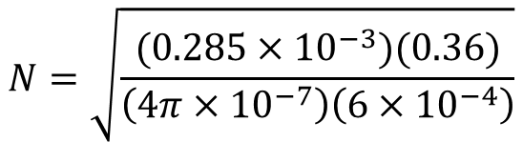
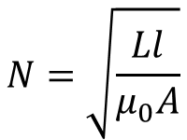
Question 2: ANSWERS
(a) Find the number of turns of the solenoid
Use the definition of the inductance of a solenoid
$$L=\frac{μ_{0}N^{2}A}{l}$$
$$N=\sqrt{\frac{Ll}{μ_{0}A}}$$
$$N=\sqrt{\frac{(0.285×{10}^{−3})(0.36)}{\left(4π×{10}^{−7}\right)\left(6×{10}^{−4}\right)}}$$
$$N=369 turns$$
(a) The induced EMF
$$ε=−L\frac{dI}{dt}$$
$$−12.5×{10}^{−3}=−(0.285×{10}^{−3})\frac{dI}{dt}$$
$$\frac{dI}{dt}=43.9 A∙s^{−1}$$

Slide 12
Question 3
Ignoring any mutual inductance, what is the equivalent inductance of two inductors connected
in series,
in parallel?

Slide 13
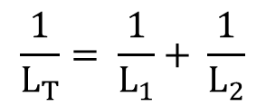

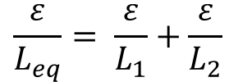



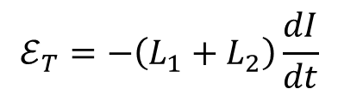
Question 3: ANSWERS
(a) When connected in series
When connected in series the voltage drops across each inductor will add, while the currents in each inductor are the same.
$$ℰ_{T}=− L_{1}\frac{dI}{dt}−L_{2}\frac{dI}{dt}$$
$$ℰ_{T}=−\left(L_{1}+L_{2}\right)\frac{dI}{dt}$$
$$ℰ_{T}= ℰ_{1}+ ℰ_{2}$$
$$L_{T}= L_{1}+ L_{2}$$
(b) When connected in parallel
When connected in parallel the currents in each inductor add to the equivalent current, while the voltage drop across each inductor is the same as the equivalent voltage drop.
$$\frac{dI}{dt}= \frac{{dI}_{1}}{dt}+\frac{{dI}_{2}}{dt}$$
$$\frac{ε}{L_{eq}}= \frac{ε}{L_{1}}+\frac{ε}{L_{2}}$$
$$\frac{1}{L_{T}}= \frac{1}{L_{1}}+ \frac{1}{L_{2}}$$

Slide 14
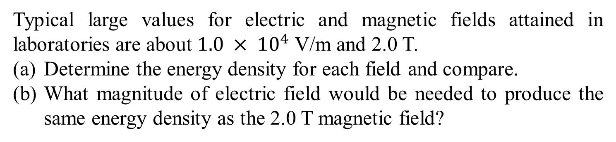
Question 4
Typical large values for electric and magnetic fields attained in laboratories are about $1.0 × {10}^{4}$ V/m and 2.0 T.
Determine the energy density for each field and compare.
What magnitude of electric field would be needed to produce the same energy density as the 2.0 T magnetic field?

Slide 15
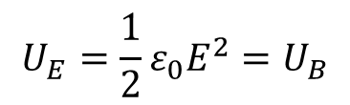



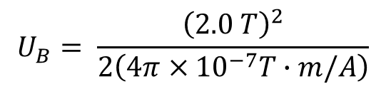

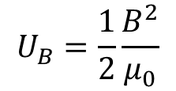
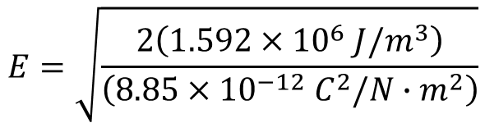
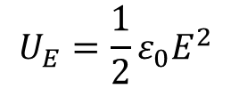
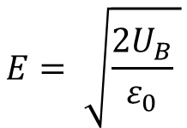
Question 4: ANSWERS
(a) Determine the energy density
$$U_{E}=\frac{1}{2}ε_{0}E^{2}$$
$$U_{E}= \frac{1}{2}\left(8.85×{10}^{−12} C^{2}/N∙m^{2}\right){\left(1.0×{10}^{4} N/C\right)}^{2}$$
$$U_{E}=4.4×{10}^{−4} J/m^{3}$$
$$U_{B}=\frac{1}{2}\frac{B^{2}}{μ_{0}}$$
$$U_{B}= \frac{{\left(2.0 T\right)}^{2}}{2\left(4π×{10}^{−7}T∙m/A\right)}$$
$$U_{B}=1.592×{10}^{6} J/m^{3}$$
(b) energy stored in the electric and magnetic energy fields
$$U_{E}=\frac{1}{2}ε_{0}E^{2}=U_{B}$$
$$E= \sqrt{\frac{2U_{B}}{ε_{0}} }$$
$$E=\sqrt{\frac{2\left(1.592×{10}^{6} J/m^{3}\right)}{\left(8.85×{10}^{−12} C^{2}/N∙m^{2}\right)}}$$
$$E=6.0×{10}^{8} N/C$$

Slide 16
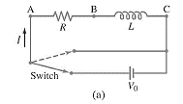
Question 5
After how many time constants does the current in the figure below reach within
5.0%,
1.0%, and
0.10% of its maximum value?
Or (a) 95% (b) 99% (c) 99.9% of its maximum value.

Slide 17



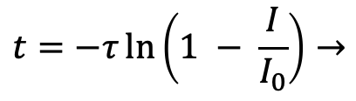


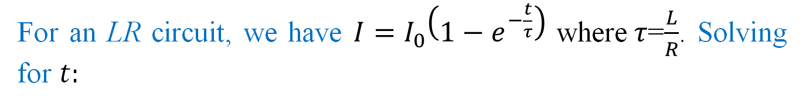


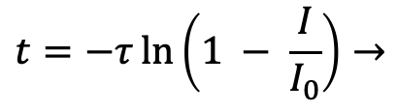
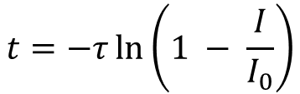
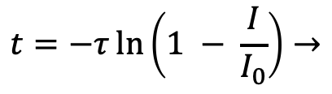

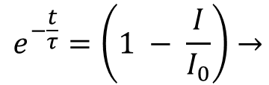


Question 5: ANSWERS
For an LR circuit, we have $I=I_{0}\left(1−e^{−\frac{t}{τ}}\right)$ where$τ$=$\frac{L}{R}$. Solving for $t:$
$$e^{−\frac{t}{τ}}=\left(1 − \frac{I}{I_{0}}\right)→$$
$$t=−τ\ln\left(1 − \frac{I}{I_{0}}\right)$$
$$I=I_{0}\left(1−e^{−\frac{t}{τ}}\right)→$$
(b) $I=0.99 I_{0}$
(c) $I=0.999 I_{0}$
(a) $I=0.95 I_{0}$
$$t=−τ\ln\left(1 − \frac{I}{I_{0}}\right)→$$
$$t=−τ\ln\left(1 − \frac{I}{I_{0}}\right)→$$
$$t=−τ\ln\left(1 − \frac{I}{I_{0}}\right)→$$
$$t=−τ \ln\left(1−0.999\right)$$
$$t=−τ \ln\left(1−0.95\right)$$
$$t=−τ \ln\left(1−0.99\right)$$
$$t=4.6 τ$$
$$t=6.9 τ$$
$$t=3.0 τ$$

Slide 18
Question 6
A 425 pF capacitor is charged to 135 V and then quickly connected to a 175 mH inductor. Determine
the frequency of oscillation,
the peak value of the current, and
the maximum energy stored in the magnetic field of the inductor.

Slide 19
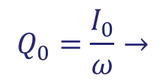
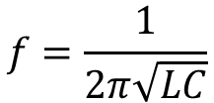

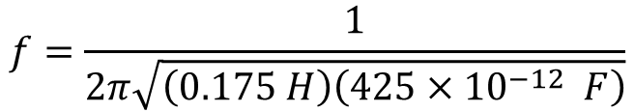




Question 6: ANSWERS
(a) the frequency of oscillation
We calculate the resonant frequency using the equation below
$$f=\frac{1}{2π\sqrt{LC}}$$
$$f=\frac{1}{2π\sqrt{\left(0.175 H\right)\left(425{×10}^{−12} F\right)}}$$
$$f=18,450 Hz$$
$$or f≈18.5 kHz$$
(b) the peak value of the current
As shown in the equation below, we set the peak current equal to the maximum charge multiplied by the angular frequency.
$$Q_{0}=\frac{I_{0}}{ω}→$$
$I_{0}= Q_{0}ω$ = $CV\left(2πf\right)$
$$I_{0}=\left(425{×10}^{−12} F\right)\left(135 V\right)\left(2π\right)\left(18,450 Hz\right)$$
$$I_{0}=6.653 × {10}^{−3} A$$
$$I_{0}≈6.65 mA$$

Slide 20
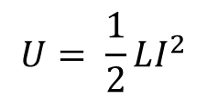


Question 6: ANSWERS
(c) maximum energy stored in the magnetic field
$$U= \frac{1}{2}LI^{2}$$
$$U= \frac{1}{2}\left(0.175 H\right){\left(6.653×{10}^{−3} A\right)}^{2}$$
$$U≈3.87 μJ$$

Slide 21
Question 7
How much resistance must be added to a pure LC circuit (L = 350 mH, C = 1800 pF) to change the oscillator's frequency by 0.25%? Will it be increased or decreased?

Slide 22
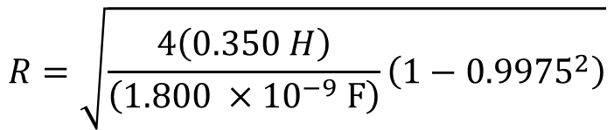

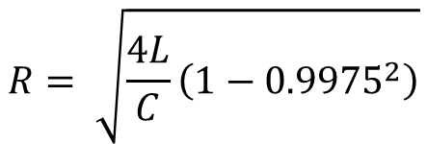

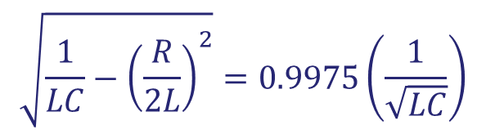



Question 7: ANSWERS
When there is no resistance in a circuit oscillation angular frequency is given by:
$$ω_{1}=\frac{1}{\sqrt{LC}}$$
When resistance is added to a circuit oscillation angular frequency is given by:
$$ω_{2}=\sqrt{\frac{1}{LC}−{\left(\frac{R}{2L}\right)}^{2}}$$
Now from the above equations it is clear that when we add resistance in the circuit oscillation angular frequency will decrease.
$$\sqrt{\frac{1}{LC}−{\left(\frac{R}{2L}\right)}^{2}}=0.9975\left(\frac{1}{\sqrt{LC}}\right)$$
$$ω_{2}=\left(1−0.0025\right)ω_{1}→$$
$$ω_{2}=0.9975ω_{1}→$$
$$R= \sqrt{\frac{4L}{C}\left(1−{0.9975}^{2}\right)}$$
$$R=\sqrt{\frac{4\left(0.350 H\right)}{\left(1.800 ×{10}^{−9} F\right)}\left(1−{0.9975}^{2}\right)}$$
$$R=1.97 kΩ$$

Slide 23
Question 8
What is the reactance of a 9.2 μF capacitor at a frequency of
60.0 Hz,
l.00 MHz?

Slide 24

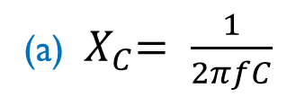
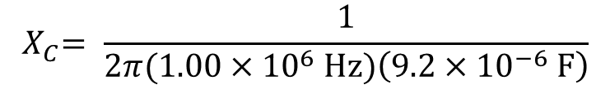
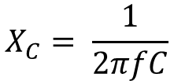



Question 8: ANSWERS
The reactance of a capacitor is given by:
$$X_{C}= \frac{1}{2πfC}$$
(a)${ X}_{C}= \frac{1}{2πfC}$
$${ X}_{C}=\frac{1}{2π\left(60 Hz\right)\left(9.2×{10}^{−6} F\right)}$$
$${ X}_{C}=290 Ω$$
(b)${ X}_{C}= \frac{1}{2πfC}$
$${ X}_{C}= \frac{1}{2π(1.00×{10}^{6} Hz)\left(9.2×{10}^{−6} F\right)}$$
$${ X}_{C}=1.{7×10}^{−2} Ω$$

